Slide 1
Discrete random variable

Slide 2
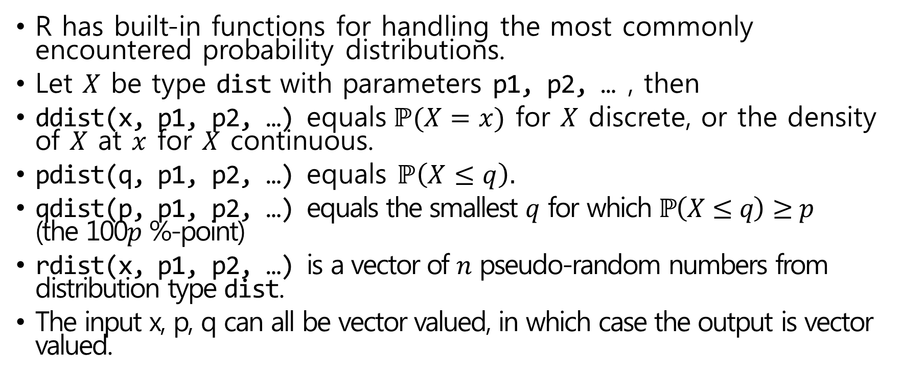
Discrete random variable in R
R has built-in functions for handling the most commonly encountered probability distributions.
Let $X$ be type dist with parameters p1, p2, … , then
ddist(x, p1, p2, …) equals $\text{ℙ}(X=x)$ for $X$ discrete, or the density of $X$ at $x$ for $X$ continuous.
pdist(q, p1, p2, …) equals $\text{ℙ}\left(X≤q\right).$
qdist(p, p1, p2, …) equals the smallest $q$ for which $\text{ℙ}\left(X≤q\right)≥p$ (the 100$p$ %-point)
rdist(x, p1, p2, …) is a vector of $n$ pseudo-random numbers from distribution type dist.
The input x, p, q can all be vector valued, in which case the output is vector valued.

Slide 3

Some of discrete distributions in R
Some of the discrete distributions provided by R, together with the names of their parameter inputs.
pbinom(5, 10, 0.5)
$\text{ℙ}(X=5)$ for $X$ which follows binomial distribution with size=10, prob =0.5.
Distribution | R name (dist) | Parameter names
Binomial | binom | size, prob
Geometric | geom | prob
Negative binomial | nbinom | size, prob
Poisson | pois | lambda

Slide 4
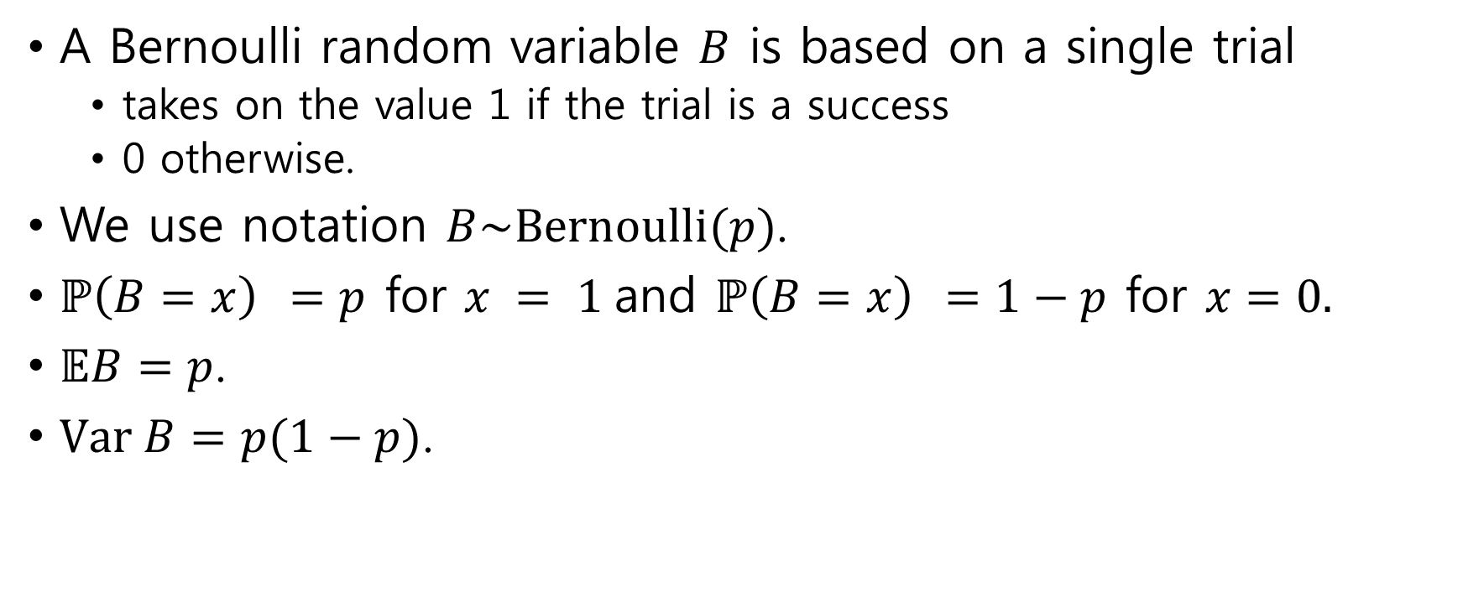
Bernoulli distribution
A Bernoulli random variable $B$ is based on a single trial
takes on the value 1 if the trial is a success
0 otherwise.
We use notation $B\sim \text{Bernoulli}(p)$.
$\text{ℙ}\left(B=x\right) =p$ for $x = 1$and $\text{ℙ}\left(B=x\right) =1−p$ for $x=0.$
$𝔼B=p$.
$\text{Var} B=p(1−p)$.

Slide 5
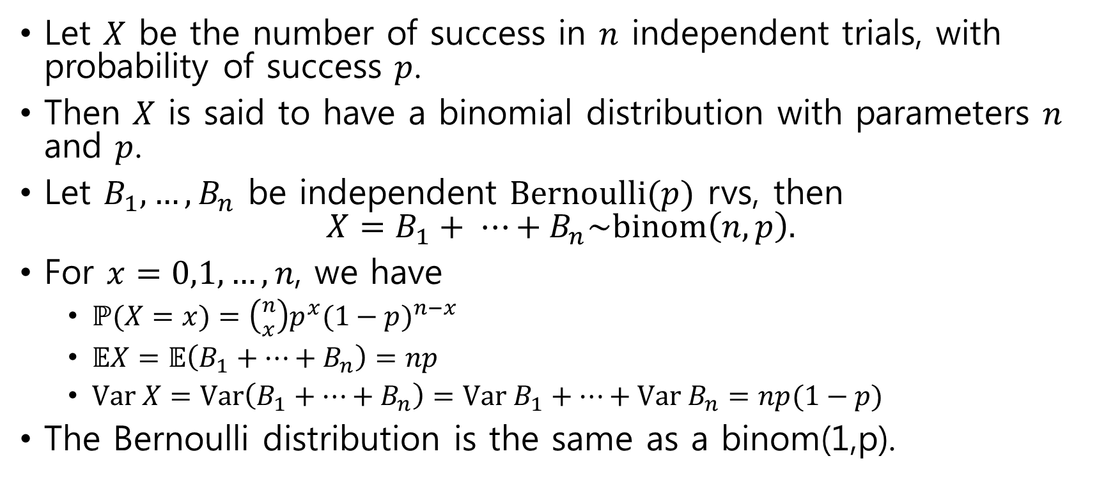
Binomial distribution
Let $X$ be the number of success in $n$ independent trials, with probability of success $p$.
Then $X$ is said to have a binomial distribution with parameters $n$ and $p$.
Let $B_{1},…, B_{n}$ be independent $\text{Bernoulli}(p)$ rvs, then $X=B_{1}+ ⋯+B_{n}\sim \text{binom}\left(n,p\right).$
For $x=0,1,…,n$, we have
$\text{ℙ}(X=x)=\left({n \atop x}\right)p^{x}{(1−p)}^{n−x}$
$𝔼X=𝔼\left(B_{1}+⋯+B_{n}\right)=np$
$\text{Var} X=\text{Var}\left(B_{1}+⋯+B_{n}\right)=\text{Var}{ B}_{1}+⋯+\text{Var} B_{n}=np(1−p)$
The Bernoulli distribution is the same as a binom(1,p).

Slide 6
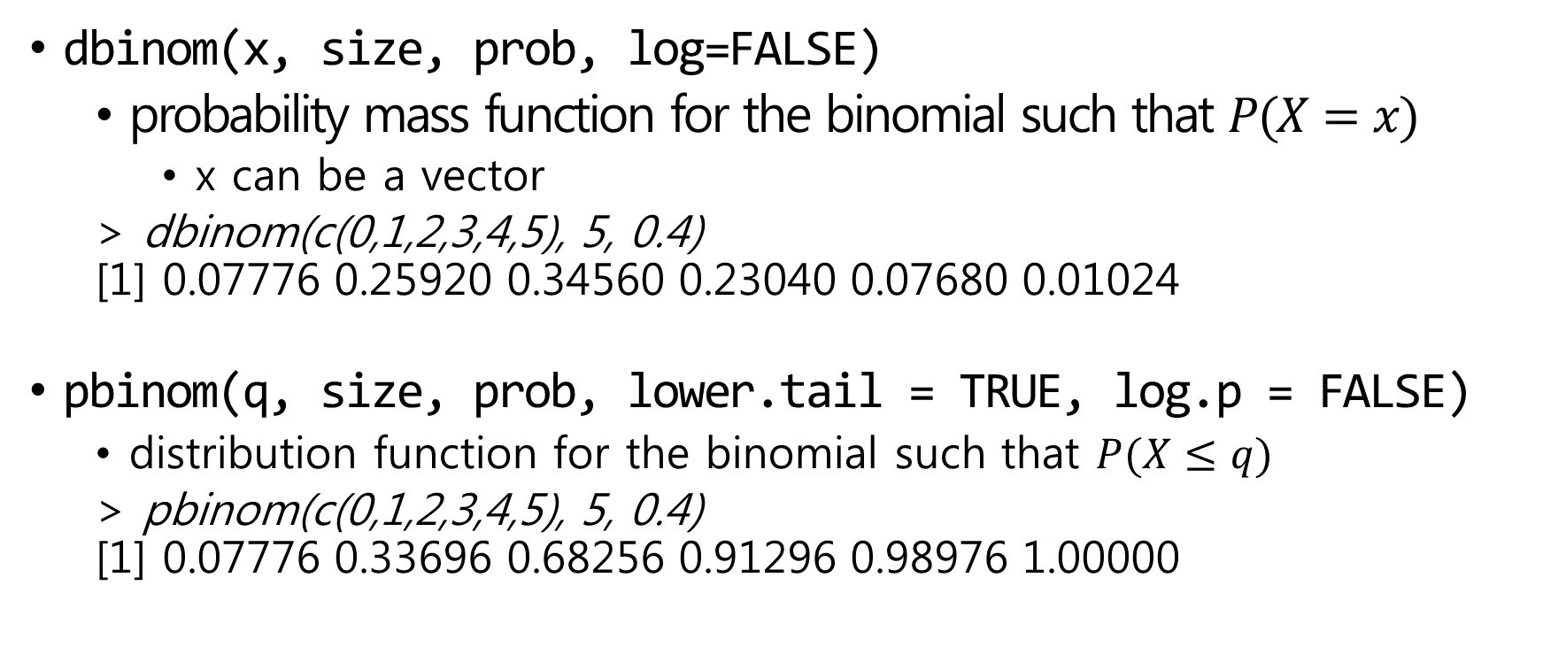
Binomial distribution in R
dbinom(x, size, prob, log=FALSE)
probability mass function for the binomial such that $P(X=x)$
x can be a vector
> dbinom(c(0,1,2,3,4,5), 5, 0.4) [1] 0.07776 0.25920 0.34560 0.23040 0.07680 0.01024
pbinom(q, size, prob, lower.tail = TRUE, log.p = FALSE)
distribution function for the binomial such that $P(X≤q)$
> pbinom(c(0,1,2,3,4,5), 5, 0.4) [1] 0.07776 0.33696 0.68256 0.91296 0.98976 1.00000

Slide 7
Binomial distribution in R(2)
qbinom(p, size, prob, lower.tail = TRUE, log.p = FALSE)
quantile function
rbinom(n, size, prob)
n observations of the binomial random variable
size : number of trial
prob : probability of success on each trial
> rbinom(5, 10, 0.4) [1] 3 5 3 1 3

Slide 8
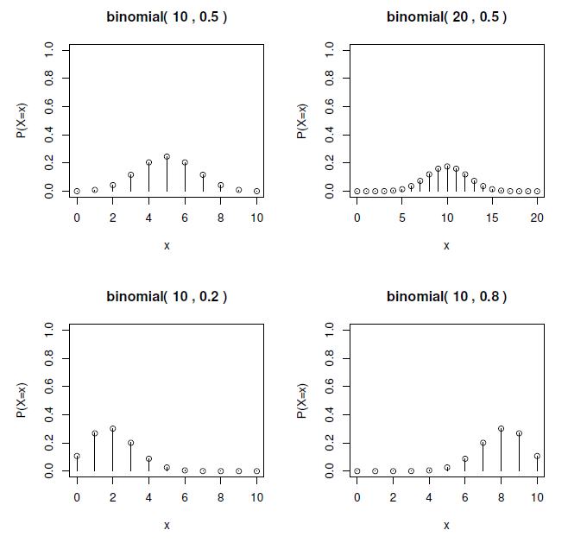
Binomial probability mass functions
par(mfrow=c(2, 2))
x <- seq(0, 20, 1)
ps <- c(0.5, 0.5, 0.2, 0.8)
trials <- c(10, 20, 10, 10)
for (i in seq(1,4)){
y <- dbinom(x, trials[i], ps[i])
plot(x,y,xlim=c(0, trials[i]), ylim=c(0,1), xlab="x",
ylab="P(X=x)", type="h")
points(x, y)
title( paste("binomial(", trials[i], “,”, ps[i], ")") )
}

Slide 9
Binomial probability distribution functions
par(mfrow=c(2, 2))
x <- seq(0, 20, 1)
ps <- c(0.5, 0.5, 0.2, 0.8)
trials <- c(10, 20, 10, 10)
for (i in seq(1,4)){
y <- pbinom(x, trials[i], ps[i])
plot(x, y, xlim=c(0, trials[i]), ylim=c(0,1), xlab="x",
ylab="P(X<=x)", type="s")
title( paste("binomial(", trials[i], ",", ps[i], ")") )
}

Slide 10
Comparison between r.v. and pmf
N <- 500; n <- 20; p <- 0.4
relative_frequency <- rep(0, n+1)
frequency <- table(rbinom(N, n, p))
nonzero_index <- as.numeric(names(frequency)) + 1
relative_frequency[ nonzero_index ] <- frequency/N
x <- 0:n pmf <- dbinom(x, n, p)
par(mfrow=c(1,2))
plot(x, relative_frequency, 'h')
plot(x, pmf, 'h')

Slide 11
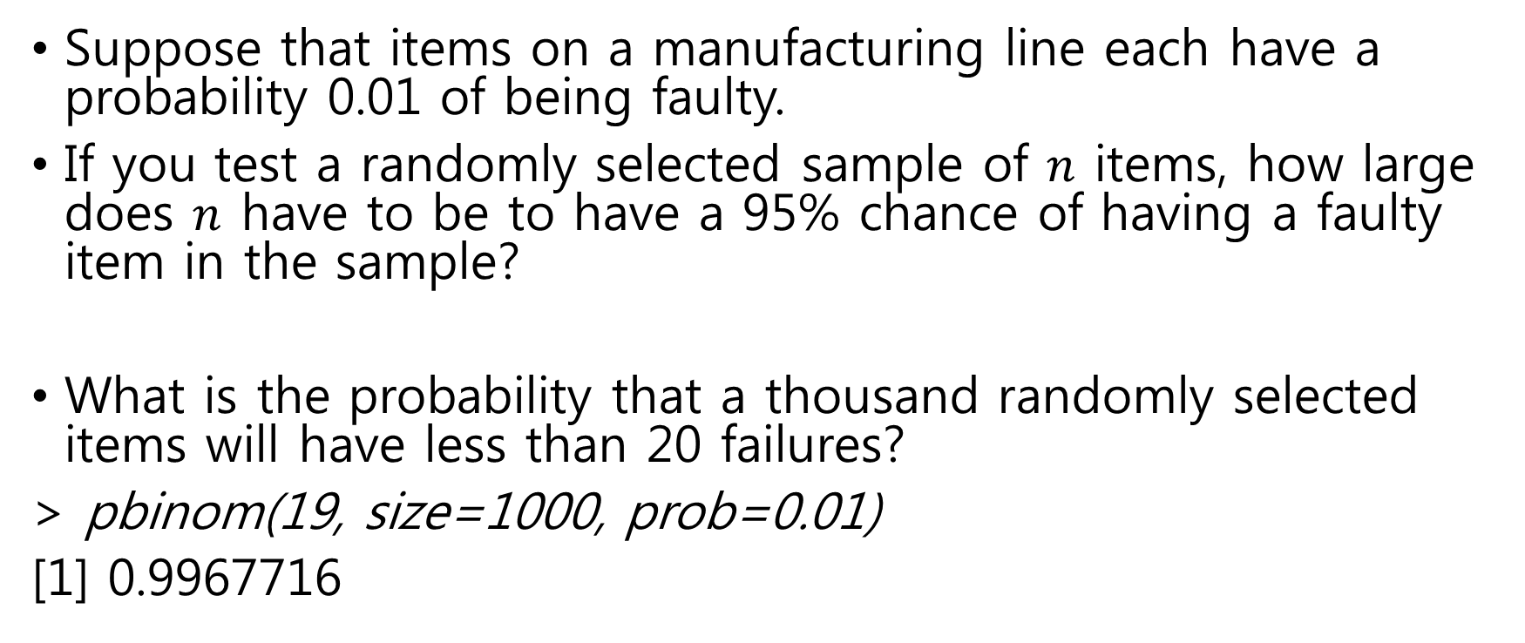
Example: sampling a manufacturing line
Suppose that items on a manufacturing line each have a probability 0.01 of being faulty.
If you test a randomly selected sample of $n$ items, how large does $n$ have to be to have a 95% chance of having a faulty item in the sample?
What is the probability that a thousand randomly selected items will have less than 20 failures?
> pbinom(19, size=1000, prob=0.01)
[1] 0.9967716

Slide 12
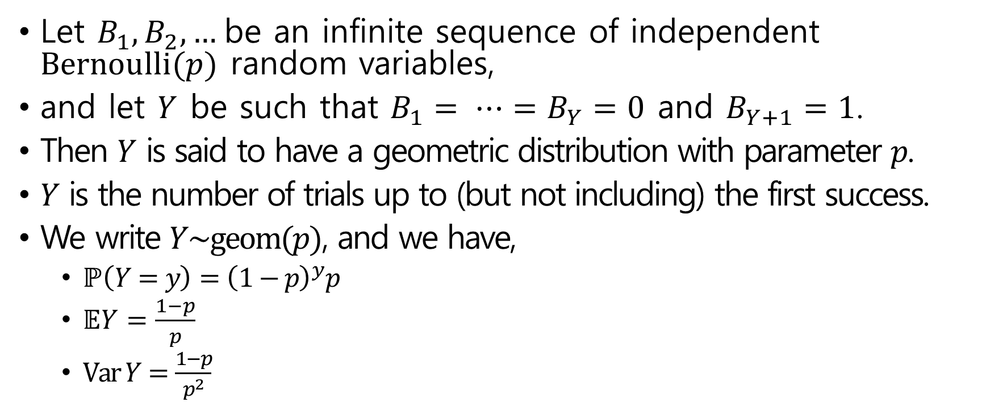
Geometric distribution
Let $B_{1},B_{2},…$be an infinite sequence of independent $\text{Bernoulli}(p)$ random variables,
and let $Y$ be such that $B_{1}= ⋯=B_{Y}=0$ and $B_{Y+1}=1$.
Then $Y$ is said to have a geometric distribution with parameter $p$.
$Y$ is the number of trials up to (but not including) the first success.
We write $Y\sim \text{geom}(p)$, and we have,
$\text{ℙ}\left(Y=y\right)={\left(1−p\right)}^{y}p$
$𝔼Y=\frac{1−p}{p}$
$\text{Var} Y=\frac{1−p}{p^{2}}$

Slide 13
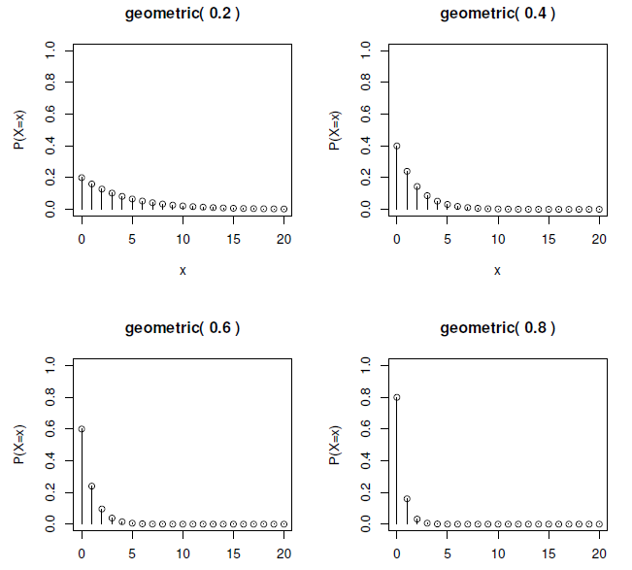
Geometric probability mass function
par(mfrow=c(2,2))
x <- seq(0,20,1)
ps <- seq(0.2,0.8,0.2)
for (p in ps){
y <- dgeom(x, p)
plot(x,y,xlim=c(0,20),ylim=c(0,1),xlab="x", ylab="P(X=x)",type="h")
points(x,y)
title(paste("geometric(",p,")"))
}

Slide 14
Geometric probability distribution function

Slide 15
Comparison with simulation
N <- 500; p <- 0.4; xmax <- 20
relative_frequency <- rep(0, xmax +1)
frequency <- table(rgeom(N, p))
relative_frequency[ as.numeric(names(frequency))+1 ] <- frequency)N
x <- 0:n
pmf <- dgeom(x, p)
par(mfrow=c(1,2))
plot(x, relative_frequency, 'h')
plot(x, pmf, 'h')

Slide 16
Comparison with simulated trials
N <- 500; p <- 0.4; xmax <- 20;
geom_rv = numeric(N)
for (i in 1:N){
n <- 0
while(TRUE){
trial <- rbinom(1, 1, 0.4)
if (trial == 1) break
n <- n+1
}
geom_rv[i] <- n
}
relative_frequency <- rep(0, xmax+1)
frequency <- table(geom_rv)
relative_frequency[as.numeric(names(frequency))+1] <- frequency/N
x <- 0:xmax; pmf <- dgeom(x, p)
par(mfrow=c(1,2))
plot(x, relative_frequency, 'h'); plot(x, pmf, 'h')

Slide 17
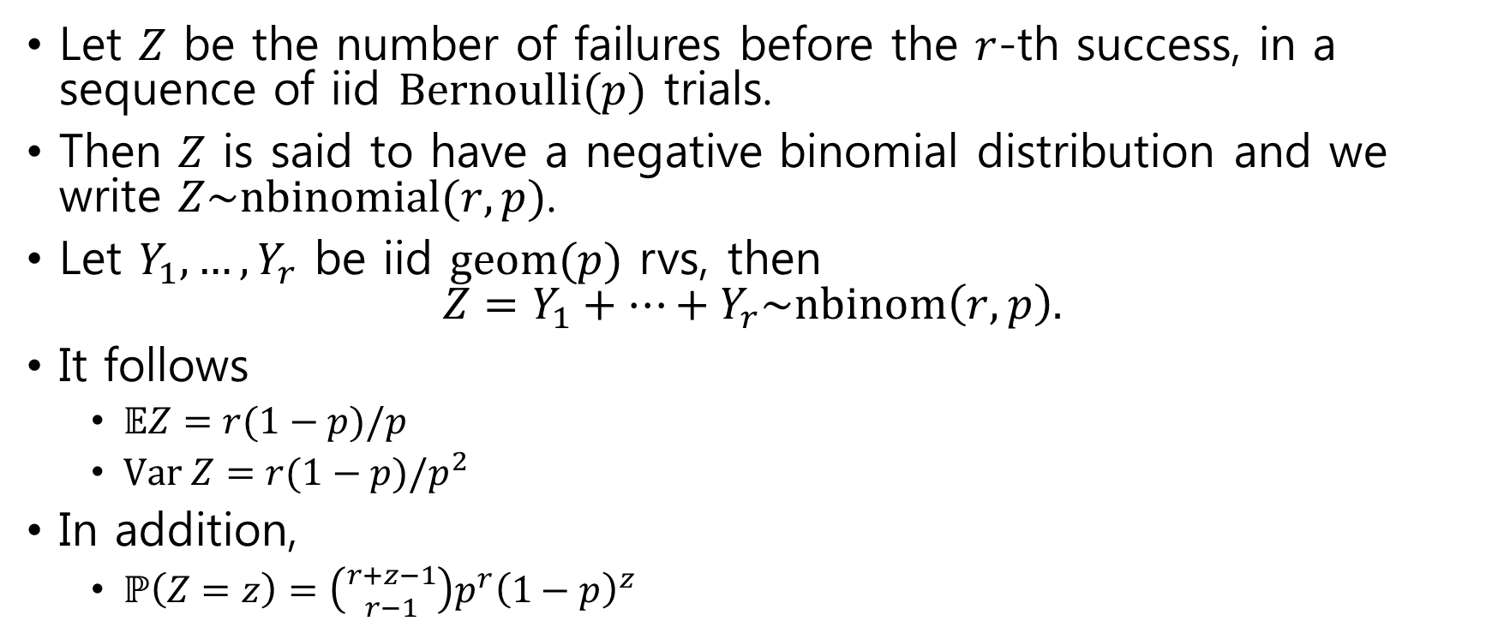
Negative binomial distribution
Let $Z$ be the number of failures before the $r$-th success, in a sequence of iid $\text{Bernoulli}(p)$ trials.
Then $Z$ is said to have a negative binomial distribution and we write $Z\sim \text{nbinomial}(r,p)$.
Let $Y_{1},…,Y_{r}$ be iid $\text{geom}(p)$ rvs, then $Z=Y_{1}+⋯+Y_{r}\sim \text{nbinom}\left(r, p\right).$
It follows
$𝔼Z=r(1−p)/p$
$\text{Var} Z=r(1−p)/p^{2}$
In addition,
$\text{ℙ}\left(Z=z\right)=\left({r+z−1 \atop r−1}\right)p^{r}{\left(1−p\right)}^{z}$

Slide 18
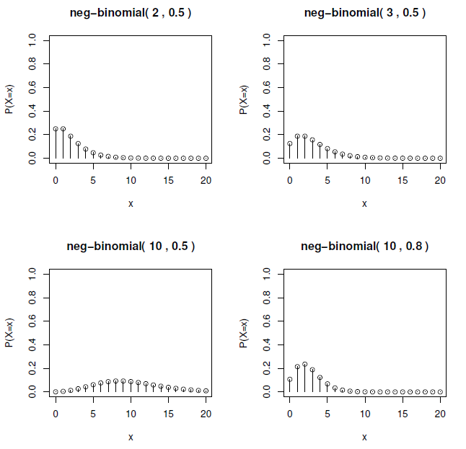
Negative binomial probability mass function
par(mfrow=c(2,2))
x <- seq(0,20,1)
sizes = c(2, 3, 10, 10)
probs = c(0.5, 0.5, 0.5, 0.8)
for (i in seq(1,4)){
y <- dnbinom(x, sizes[i], probs[i])
plot(x,y,xlim=c(0,20),ylim=c(0,1),xlab="x", ylab="P(X=x)",type="h")
points(x,y)
title(paste("neg-binomial(", sizes[i], ",", probs[i], ")"))
}

Slide 19
Negative binomial distribution function

Slide 20
Comparison with simulated trials
N <- 500; r <- 3; p <- 0.4; xmax <- 20;
nbinom_rv = numeric(N)
for (i in 1:N){
total_trial <- 0
total_success <- 0
while(TRUE){
total_success <- total_success + rbinom(1, 1, p)
total_trial <- total_trial + 1
if (total_success == r) break
}
nbinom_rv[i] <- total_trial - total_success
}
relative_frequency <- rep(0, xmax+1)
frequency <- table(nbinom_rv)
relative_frequency[as.numeric(names(frequency))+1] <- frequency/N
x <- 0:xmax; pmf <- dnbinom(x, r, p)
par(mfrow=c(1,2))
plot(x, relative_frequency[1:length(x)], 'h'); plot(x, pmf, 'h')

Slide 21
Comparison with simulated trials(2)

Slide 22
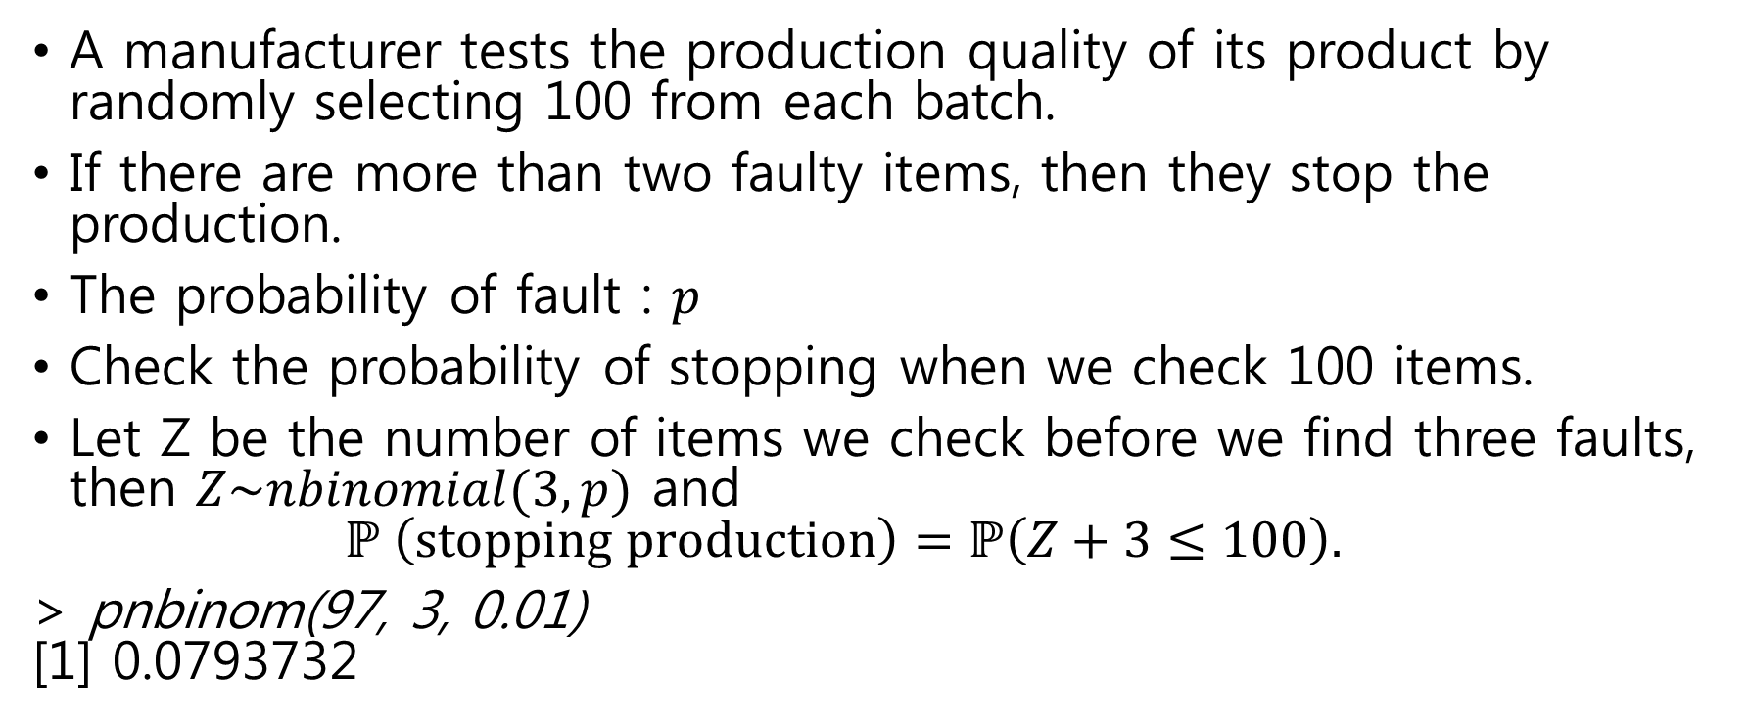
Example: quality control
A manufacturer tests the production quality of its product by randomly selecting 100 from each batch.
If there are more than two faulty items, then they stop the production.
The probability of fault : $p$
Check the probability of stopping when we check 100 items.
Let Z be the number of items we check before we find three faults, then $Z\sim nbinomial(3,p)$ and $ℙ \left(\text{stopping} \text{production}\right)=ℙ\left(Z+3≤100\right).$
> pnbinom(97, 3, 0.01) [1] 0.0793732

Slide 23
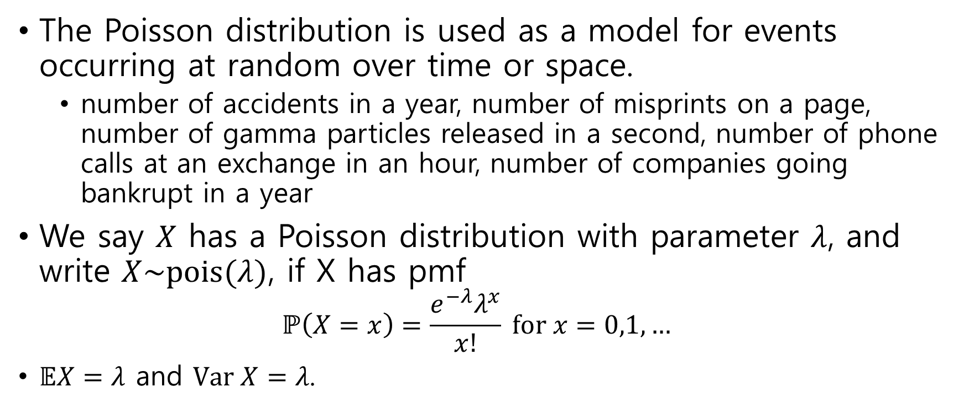
Poisson distribution
The Poisson distribution is used as a model for events occurring at random over time or space.
number of accidents in a year, number of misprints on a page, number of gamma particles released in a second, number of phone calls at an exchange in an hour, number of companies going bankrupt in a year
We say $X$ has a Poisson distribution with parameter $λ$, and write $X\sim \text{pois}(λ)$, if X has pmf $ℙ\left(X=x\right)=\frac{e^{−λ}λ^{x}}{x!} \text{for} x=0,1,…$
$𝔼X=λ$ and $\text{Var} X=λ$.

Slide 24
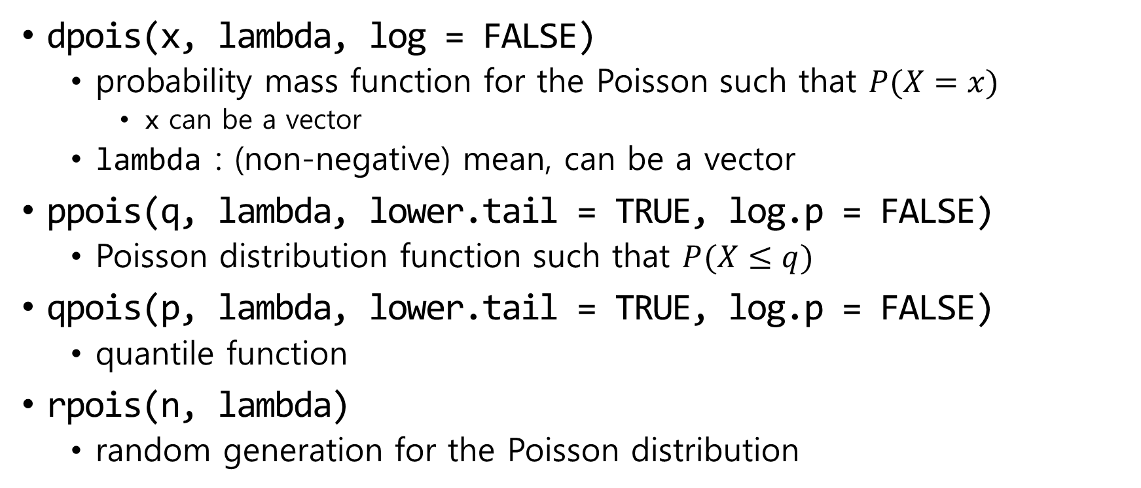
Poisson distribution in R
dpois(x, lambda, log = FALSE)
probability mass function for the Poisson such that $P(X=x)$
x can be a vector
lambda : (non-negative) mean, can be a vector
ppois(q, lambda, lower.tail = TRUE, log.p = FALSE)
Poisson distribution function such that $P(X≤q)$
qpois(p, lambda, lower.tail = TRUE, log.p = FALSE)
quantile function
rpois(n, lambda)
random generation for the Poisson distribution

Slide 25
Poisson probability mass function
par(mfrow=c(2, 2))
x <- seq(0, 20, 1)
lambdas = c(0.1, 1, 5, 10)
for (lambda in lambdas){
y <- dpois(x, lambda)
plot(x,y,xlim=c(0,20), ylim=c(0,1), xlab="x", ylab="P(X=x)", type="h")
points(x, y)
title(paste("Poisson(", lambda, ")"))
}

Slide 26
Poisson probability density function

Slide 27
Comparison with simulation
N <- 500; lambda <- 10; xmax <- 20
relative_frequency <- rep(0, xmax +1)
frequency <- table(rpois(N, lambda))
idx <- as.numeric(names(frequency))+1
relative_frequency[idx] <- frequency/N
x <- 0:xmax
pmf <- dpois(x, lambda)
par(mfrow=c(1,2))
plot(x, relative_frequency[1:(xmax+1)], 'h')
plot(x, pmf, 'h')

Slide 28

Poisson approximation to binomial
When $n$ is large and $p$ is small, binom($n,p$) is approximated by Poiss($np$).
n <- 200; p <- 0.003; x<-0:10
par(mfrow=c(1,2))
plot(x, dbinom(x, n, p), 'h')
plot(x, dpois(x, n*p), 'h')

Slide 29
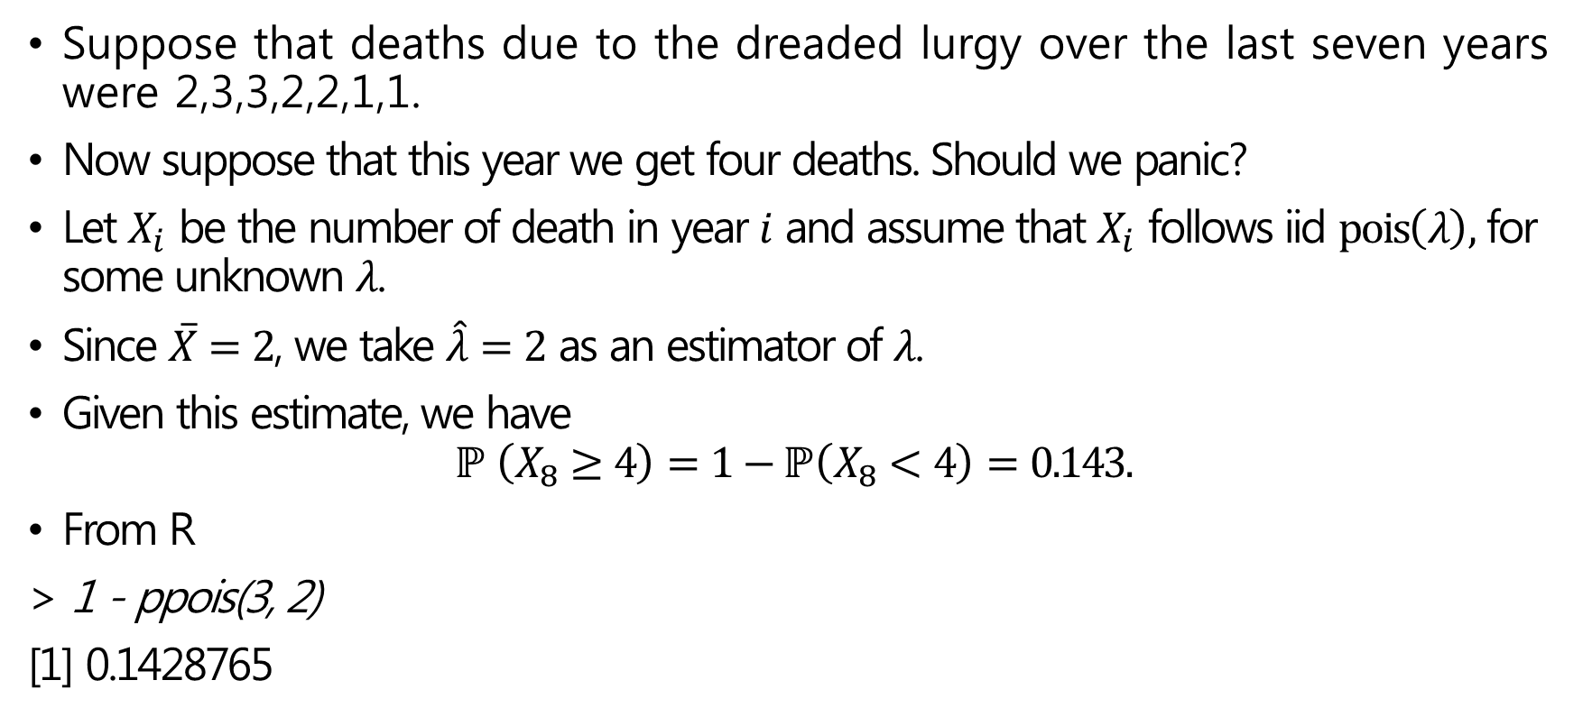
Example: the dreaded lurgy
Suppose that deaths due to the dreaded lurgy over the last seven years were 2,3,3,2,2,1,1.
Now suppose that this year we get four deaths. Should we panic?
Let $X_{i}$ be the number of death in year $i$ and assume that $X_{i}$ follows iid $\text{pois}\left(λ\right),$ for some unknown $λ$.
Since $\overline{X}=2$, we take $\hat{λ}=2$ as an estimator of $λ$.
Given this estimate, we have $ℙ \left(X_{8}≥4\right)=1−ℙ\left(X_{8}<4\right)=0.143.$
From R
> 1 - ppois(3, 2)
[1] 0.1428765

